Slide 1


GraphIQ
Presented by
Name | S.R.
Rishabh Indoria | 24002
Kirtan Vora Jatin | 24573
Amrit Lal | 24608
Jitendra Verma | 24098

Slide 2
PROBLEM
Academic content is large, unstructured, and hard to navigate, making it difficult for students to extract key concepts, relationships, and prerequisites across textbooks, PDFs, and lecture notes.
LLMs alone hallucinate and lack grounding, while pure retrieval systems miss deeper reasoning, creating the need for a system that can understand, structure, and reason over academic material reliably.

Slide 3






TECHNOLOGIES

Slide 4
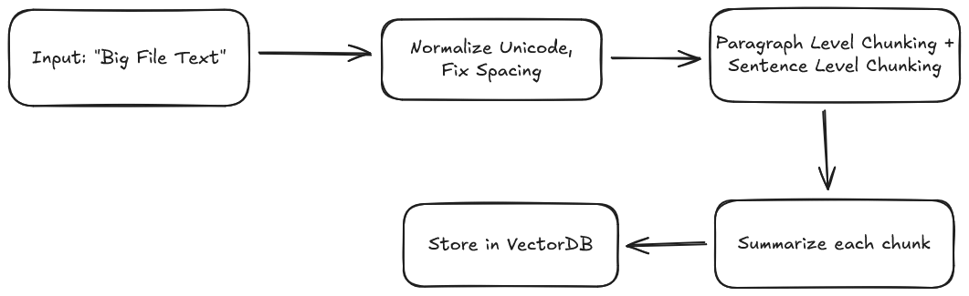
INGESTION & ENRICHMENT

Slide 5
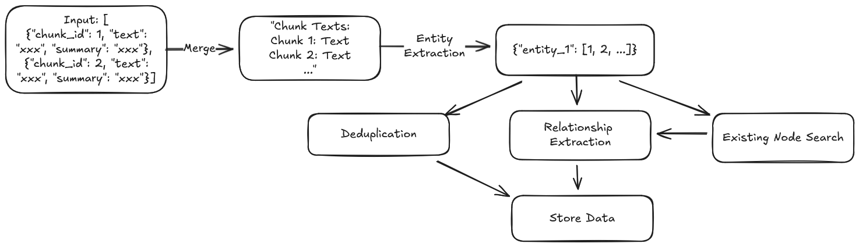
ENTITY & RELATION EXTRACTION

Slide 6
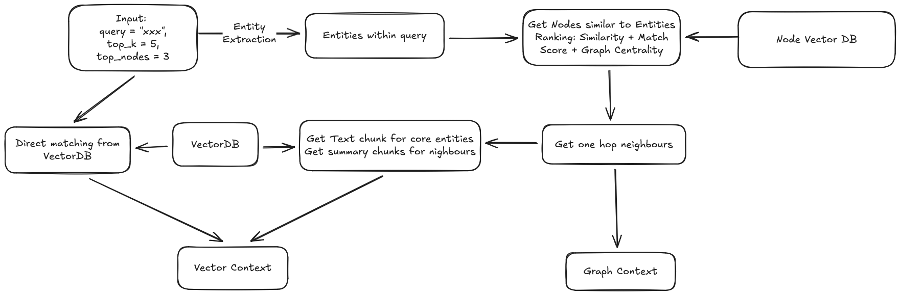
RETRIEVAL

Slide 7
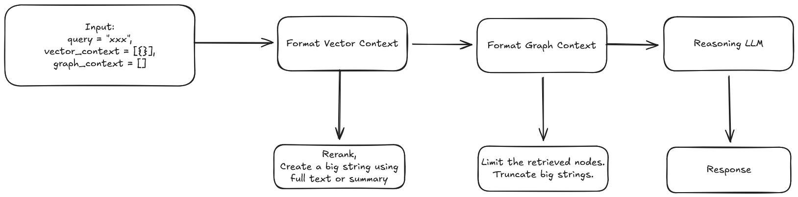
REASONING & INSIGHTS

Slide 8
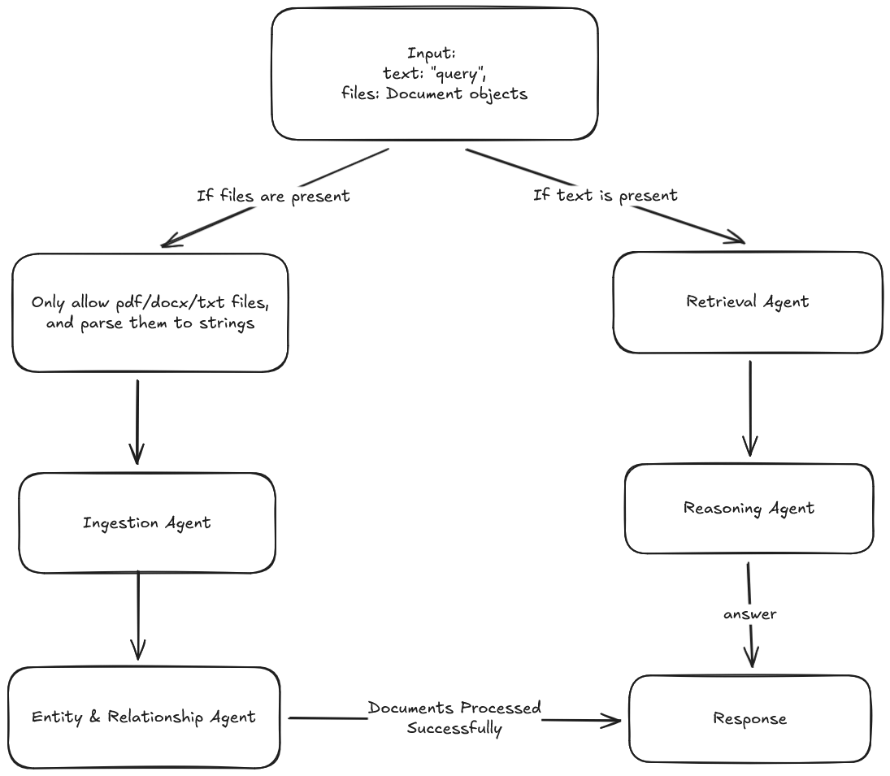
Backend Pipeline

Slide 9
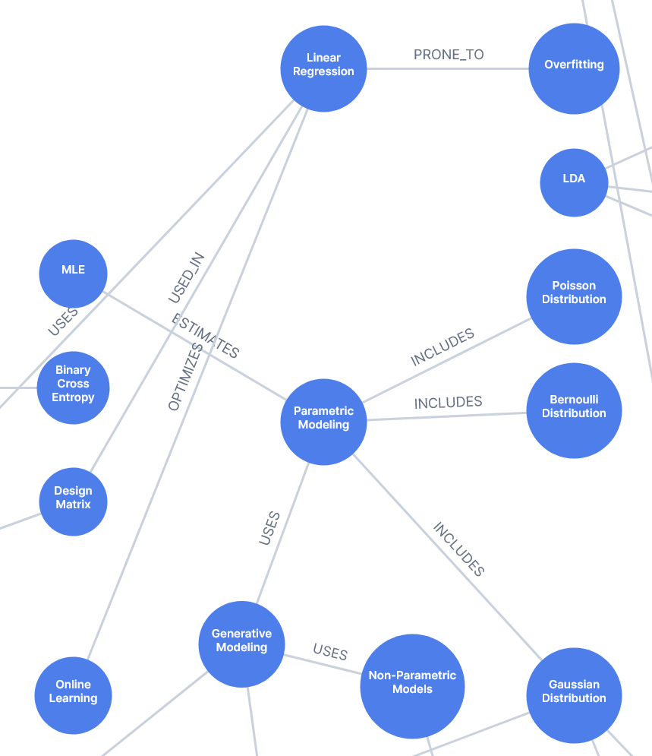
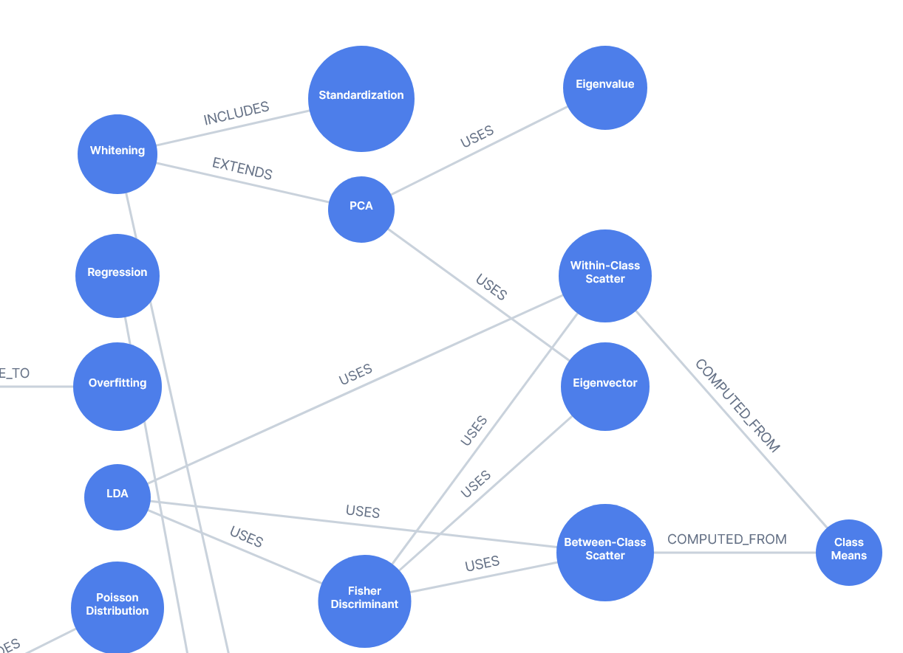
Graph Results

Slide 10
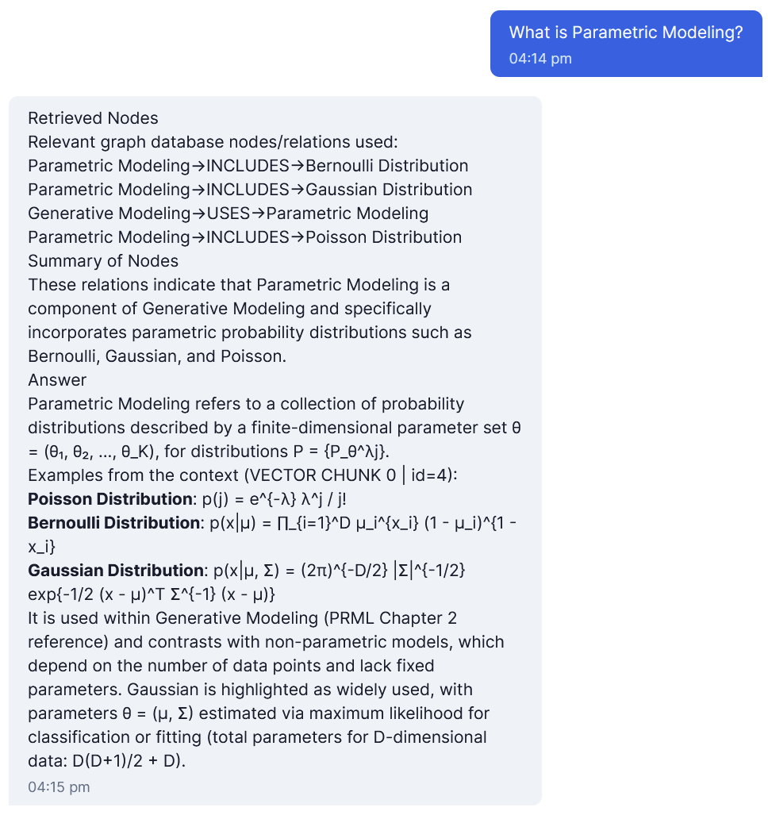
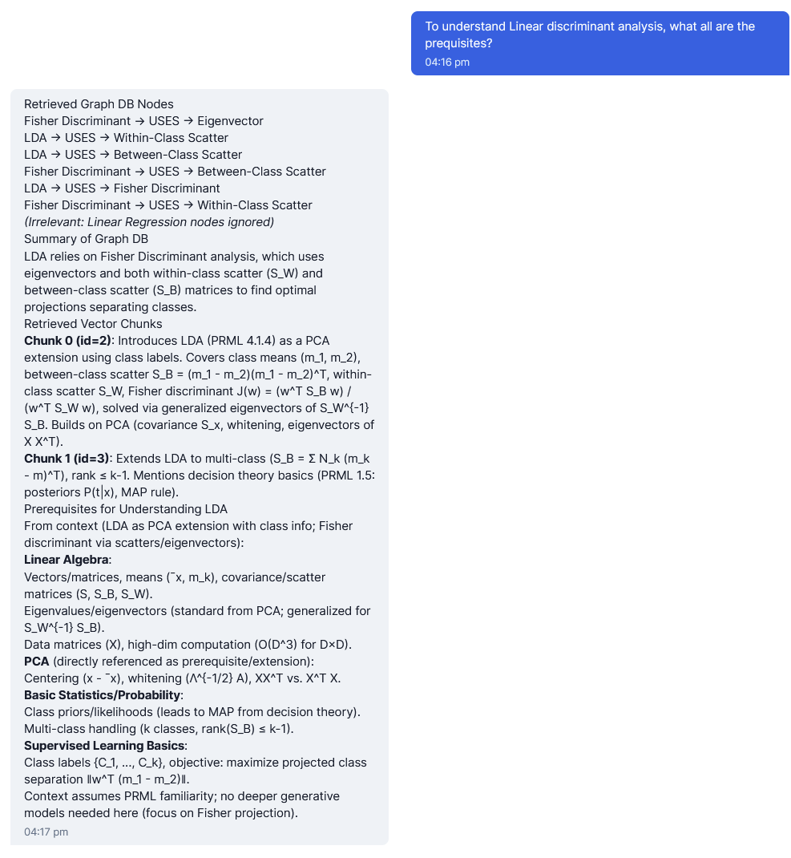
Reasoning Results

Slide 11
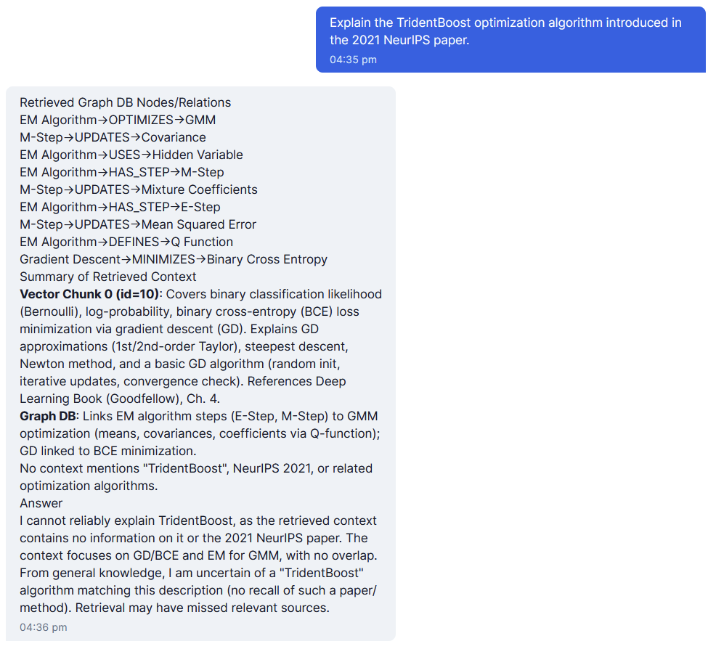
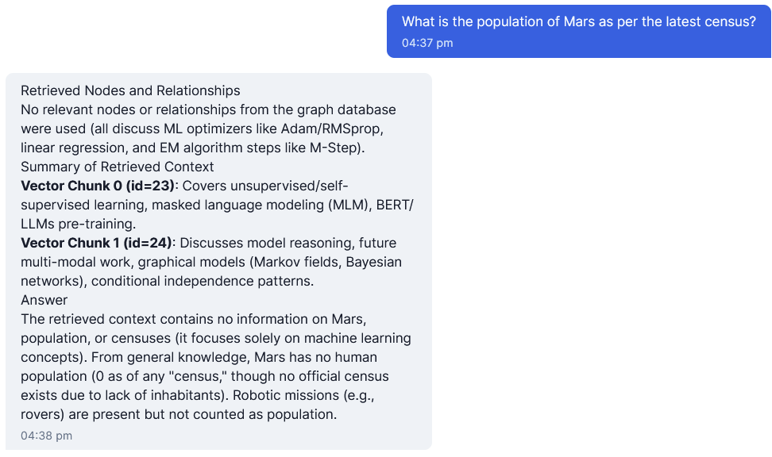
Reasoning Results

Slide 12
FUTURE WORK
Latency Issues: As of now, the Ingestion and Entity extraction pipeline takes upto 5 minutes for a 25 page dense document. This is likely due to API calls, even with batching we still see these issues.
Vector DB: We have used FAISS for this project. However, if we want to make the project production ready or even scale to include multiple users, then we would need way to much effort with FAISS. A better option would be to switch to Qdrant.

Slide 13
Thank You
For your attention

